Slide 1


X
INNOVATE
HACKATHON
AMNA ALNAQBI
SUMYAH HELAL
AYMAN MARZOUK
MAHMOUD SAYED
AHMED ALSHAFEY

Slide 2

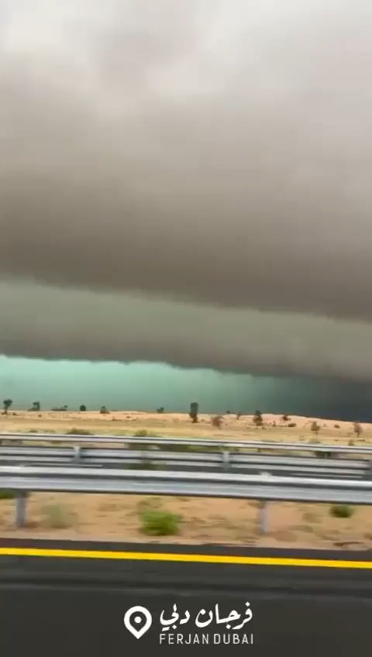

Slide 3







WHAT IS NAFDEEK
A VOLUNTEER DRIVEN INTIATIVE
BRING PEOPLE
TOGETHER
CONNECT WITH THEM THROUGH CHAT, VOICE, VIDEO, AND IN PERSON
CLOSEST VOLUNTEER LENDING AID
PROVIDE SUPPORT TO PEOPLE
OF DETERMINATION
AND SENIOR CITIZENS

Slide 4
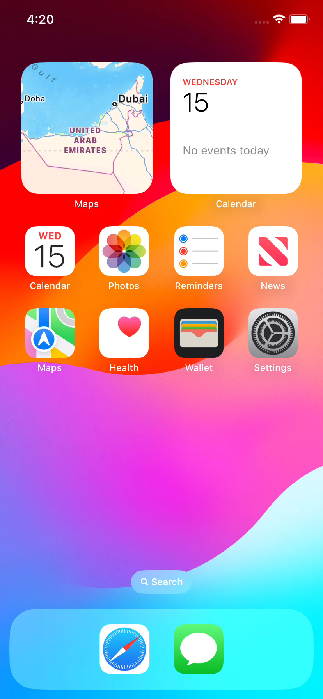






USER JOURNEY
Find nearest volunteer
Select whether Voice/ Video / Chat / In-person
Send request
Request for a volunteer
List of volunteers to choose from
Enter MOI application
&
LOGIN
Click on Nafdeek logo on the top

Slide 5
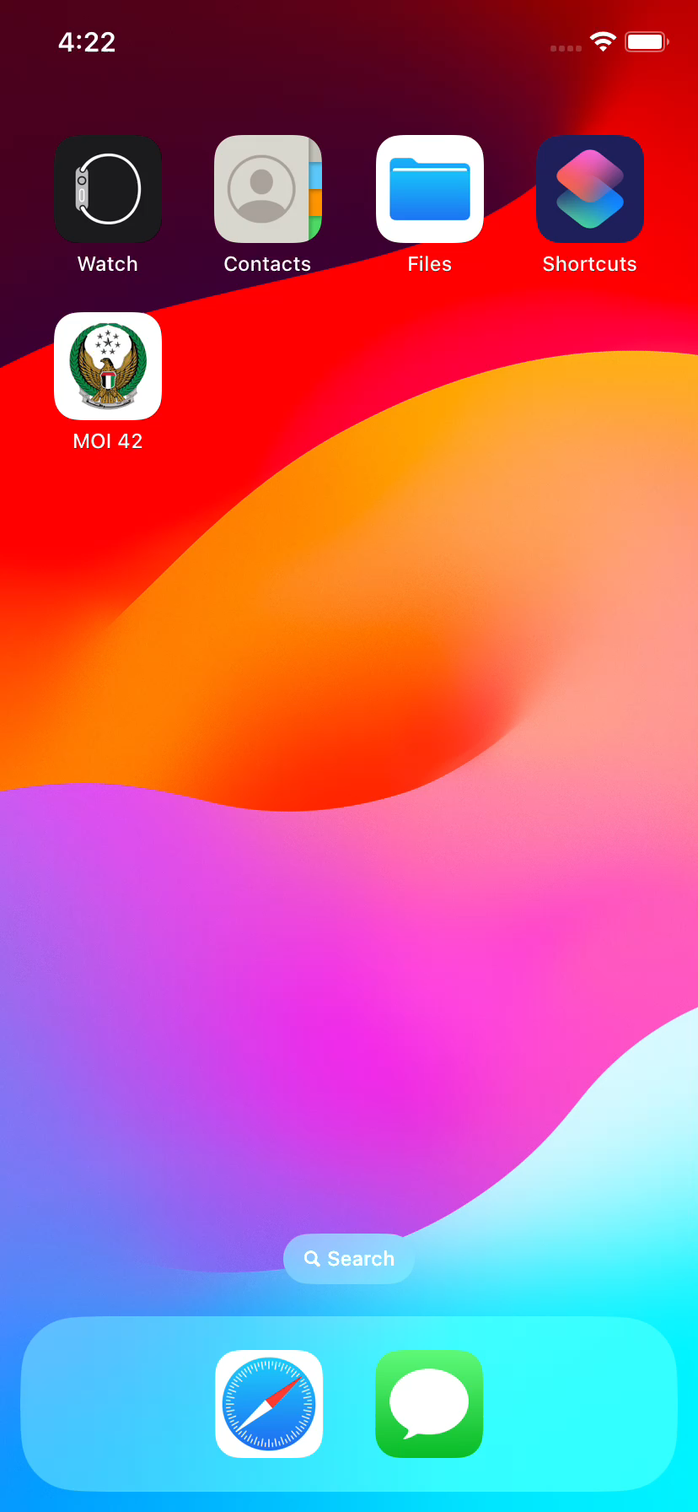





HOW TO BECOME A VOLUNTEER
Step 1
Step 2
Step 3
Step 4
Ready to go
NAFDEEK
Login
Qualifications
Availability
Confidentiality

Slide 6






Empowerment
and Inclusion
Skill
Development
for
Volunteers
Community Engagement
BENEFITS
OF
NAFDEEK
Safety
and
Security
Incentives
for
Volunteers
Scalability

Slide 7




GAMIFICATION
PHASE 1
PHASE 2
PHASE 3
PHASE 4
PHASE 5
VOLUNTEER REQUEST
Request Recieved
Complete the request
Receive feedback
Get points
Points can be reedemed

